Slide 1

I/O Management

Slide 2
Topics
I/O devices
Organization of the I/O Function
I/O Management
Disk Organization
Disk Scheduling:
FCFS
SSTF
SCAN
CSCAN
LOOK
C-LOOK

Slide 3
I/O Devices
External devices that engage in I/O with computer systems can be roughly grouped into three categories:
Human readable:
Suitable for communicating with the computer user.
Examples include printers and terminals, the latter consisting of video display, keyboard, and perhaps other devices such as a mouse.
Machine readable:
Suitable for communicating with electronic equipment.
Examples are disk drives, USB keys, sensors, controllers, and actuators.
Communication:
Suitable for communicating with remote devices.
Examples are digital line drivers and modems.

Slide 4
Organization of the I/O Function
Three techniques for performing I/O:
Programmed I/O:
The processor issues an I/O command, on behalf of a process, to an I/O module; that process then busy waits for the operation to be completed before proceeding.
Interrupt-driven I/O:
The processor issues an I/O command on behalf of a process.
There are then two possibilities.
If the I/O instruction from the process is nonblocking, then the processor continues to execute instructions from the process that issued the I/O command.
If the I/O instruction is blocking, then the next instruction that the processor executes is from the OS, which will put the current process in a blocked state and schedule another process.
Direct memory access (DMA):
A DMA module controls the exchange of data between main memory and an I/O module.
The processor sends a request for the transfer of a block of data to the DMA module, and is interrupted only after the entire block has been transferred.

Slide 5
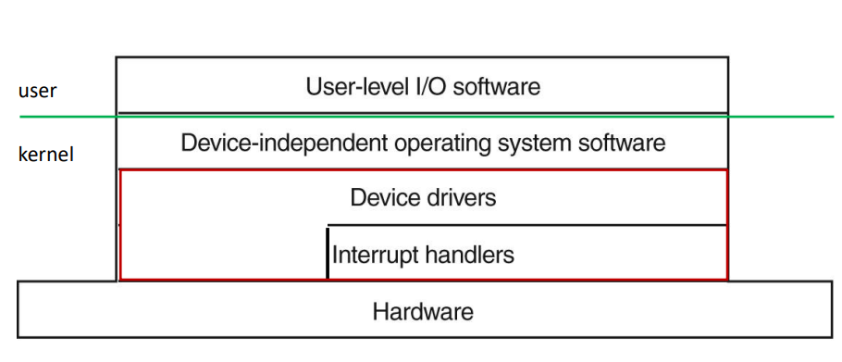
I/O Management
OS Software Layers for I/O

Slide 6
Device Drivers
Device specific code for controlling the device
Read device registers from controller
Write device registers to issue commands
Handle Interrupts
Usually supplied by the device manufacturer
Can be part of the kernel or at user-space (with system calls to access controller registers)
OS defines a standard interface that drivers for block devices must follow and another standard for driver of character devices

Slide 7
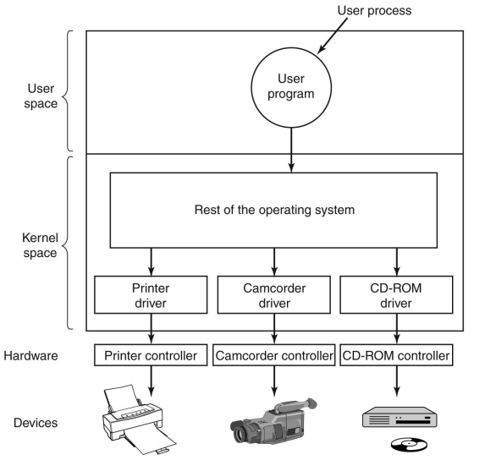
Device Drivers

Slide 8
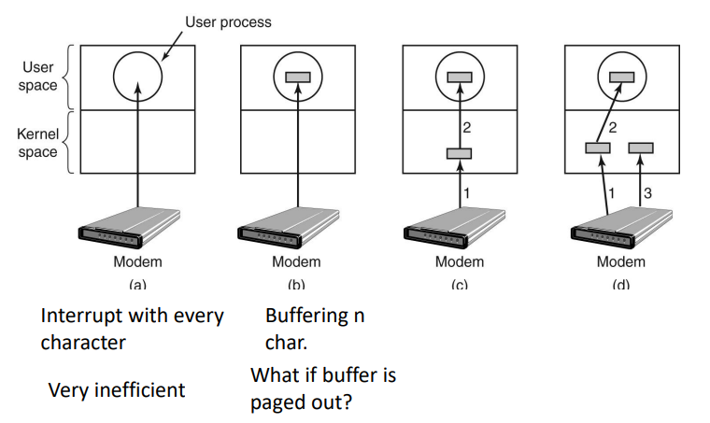
Device Independent I/O Software
Uniform interfacing for device drivers
Trying to make all devices look the same
For each class of devices, the OS defines a set of functions that the driver must supply
This layer of OS maps symbolic device names onto proper drivers

Slide 9
Disk Organization
https://www.youtube.com/watch?v=oEORcCQ62nQ

Slide 10
Disk Performance Parameters
Seek Time
Positioning time (random-access time) is time to move disk arm to desired cylinder (seek time)
Rotational Delay
Transfer Time
Transfer rate is rate at which data flow between drive and computer
Drives rotate at 4200 to 15000 rpm
Time for desired sector to rotate under the disk head (rotational latency)
Typically, we assume 10msec average
Typically, we assume 5msec average
Average bandwidth 50-80 Mbytes/sec.

Slide 11
Disk Structure
Disk drives are addressed as large 1-dimensional arrays of logical blocks, where the logical block is the smallest unit of transfer
Low-level formatting creates logical blocks on physical media
The 1-dimensional array of logical blocks is mapped into the sectors of the disk sequentially
Sector 0 is the first sector of the first track on the outermost cylinder
Mapping proceeds in order through that track, then the rest of the tracks in that cylinder, and then through the rest of the cylinders from outermost to innermost
Logical to physical address should be easy
Except for bad sectors
Non-constant # of sectors per track via constant angular velocity

Slide 12
Disk Scheduling
The operating system is responsible for using hardware efficiently — for the disk drives, this means having a fast access time and disk bandwidth
Minimize seek time
Seek time ≈ seek distance
Disk bandwidth is the total number of bytes transferred, divided by the total time between the first request for service and the completion of the last transfer

Slide 13
Disk Scheduling (Cont.)
There are many sources of disk I/O request
OS
System processes
Users processes
I/O request includes input or output mode, disk address, memory address, number of sectors to transfer
OS maintains queue of requests, per disk or device
Idle disk can immediately work on I/O request, busy disk means work must queue
Optimization algorithms only make sense when a queue exists

Slide 14
Disk Scheduling (Cont.)
Note that drive controllers have small buffers and can manage a queue of I/O requests (of varying “depth”)
Several algorithms exist to schedule the servicing of disk I/O requests
The analysis is true for one or many platters
We illustrate scheduling algorithms with a request queue (0-199)
98, 183, 37, 122, 14, 124, 65, 67
Head pointer 53

Slide 15
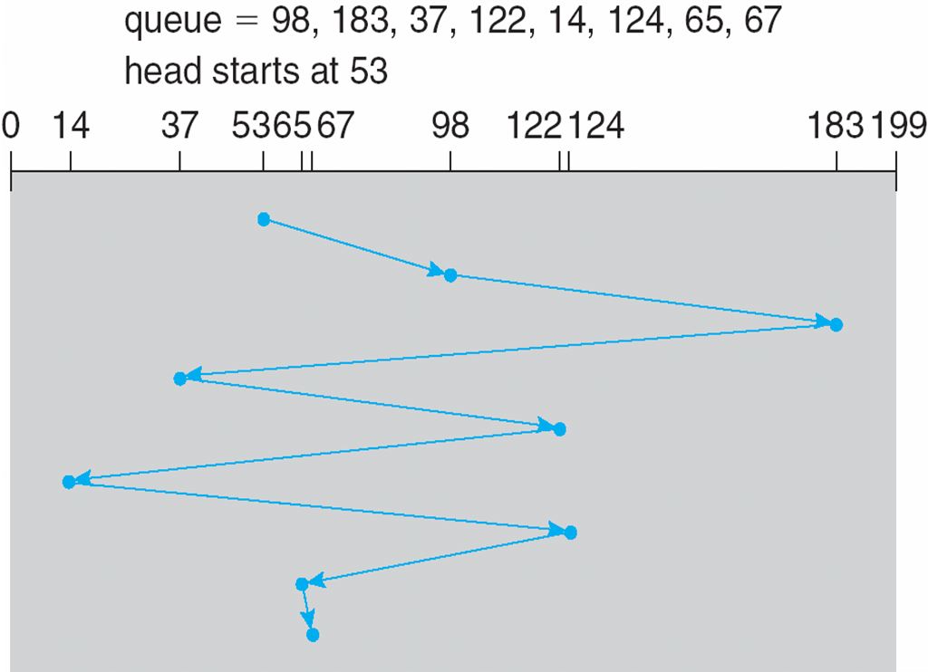
FCFS
Illustration shows total head movement of 640 cylinders

Slide 16
SSTF
Shortest Seek Time First selects the request with the minimum seek time from the current head position
SSTF scheduling is a form of SJF scheduling; may cause starvation of some requests
Illustration shows total head movement of 236 cylinders

Slide 17
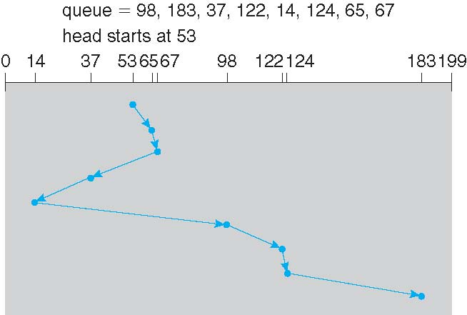
SSTF

Slide 18
SCAN
The disk arm starts at one end of the disk, and moves toward the other end, servicing requests until it gets to the other end of the disk, where the head movement is reversed and servicing continues.
SCAN algorithm Sometimes called the elevator algorithm
Illustration shows total head movement of 236 cylinders
But note that if requests are uniformly dense, largest density at other end of disk and those wait the longest

Slide 19
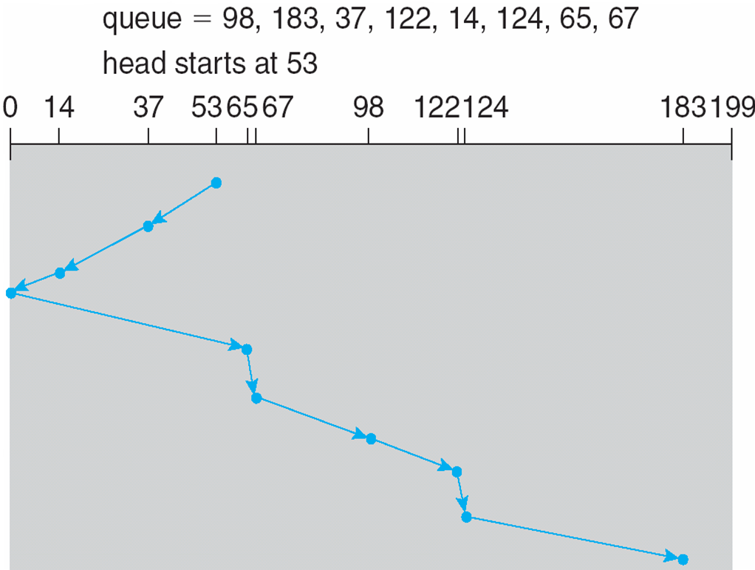
SCAN (Cont.)

Slide 20
Sequence: 98, 183, 37, 122, 14, 124, 65, 67
Head = 53
LOOK
0
14
37
53
65
67
98
122
124
183
199

Slide 21
C-SCAN
Provides a more uniform wait time than SCAN
The head moves from one end of the disk to the other, servicing requests as it goes
When it reaches the other end, however, it immediately returns to the beginning of the disk, without servicing any requests on the return trip
Treats the cylinders as a circular list that wraps around from the last cylinder to the first one
Total number of cylinders?

Slide 22
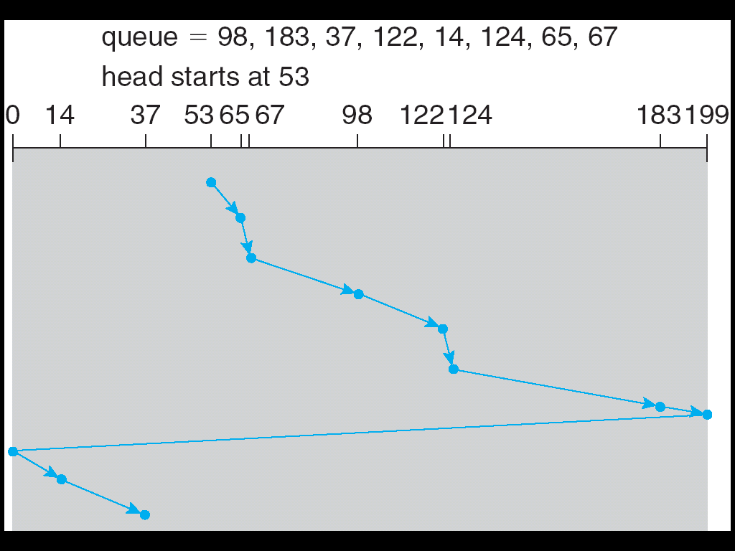
C-SCAN (Cont.)

Slide 23
C-LOOK
LOOK a version of SCAN, C-LOOK a version of C-SCAN
Arm only goes as far as the last request in each direction, then reverses direction immediately, without first going all the way to the end of the disk
Total number of cylinders?

Slide 24
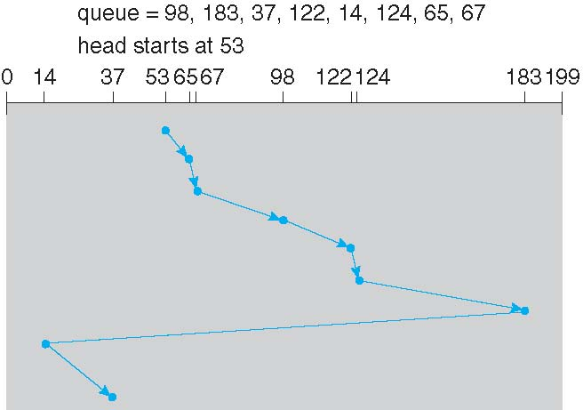
C-LOOK (Cont.)

Slide 25
Thank You

